Slide 1
MRN_0.2: An Open Hardware 3-Axis Positioner
PCTO June 26th, 2025
Stefano Allegra, Mechatronics High School Student
Federico Baldini, Computer Science High School Student
Sofia Cacciapuoti, Telecommunications High School Student
Matteo Grasselli Fontana, Computer Science High School Student
Notes:
SICUREZZA HARDWARE E Riprogettazione Meccatronica: Un Caso Studio su Voron 0.2
Divisione parti:
1-9 fede
10-14 Ste
15 sofi
16–17 matte
Domande rispondono tutti

Slide 2
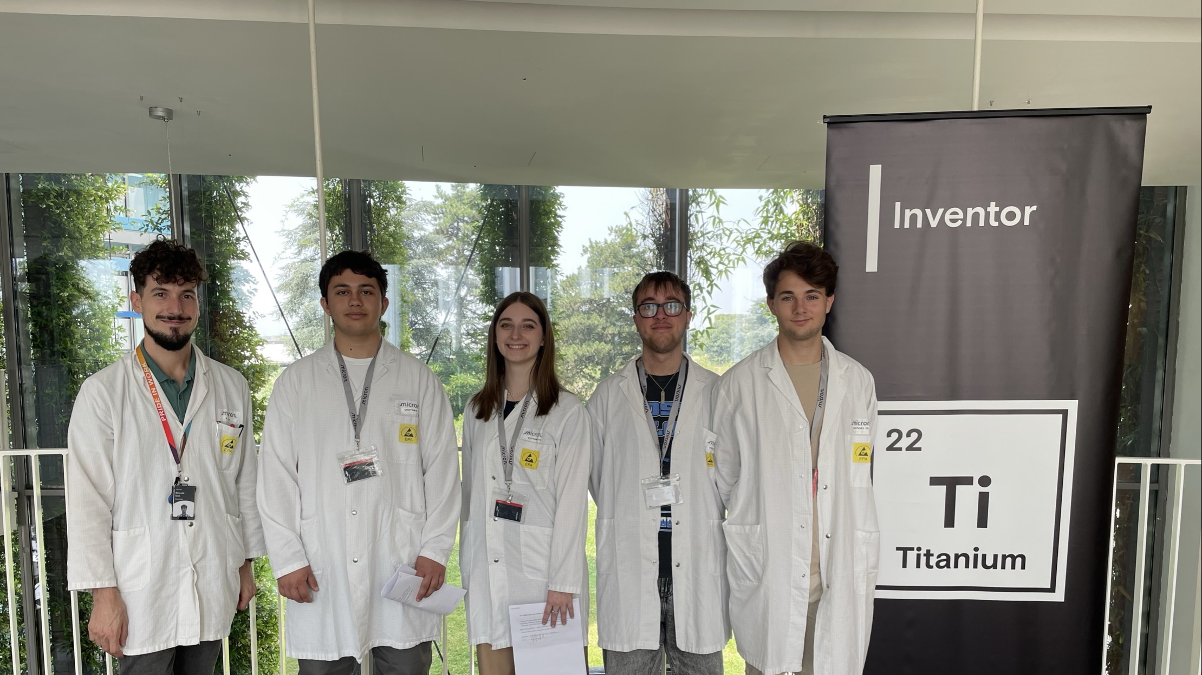
The Team
Notes:
1 minute
PCTO is an Italian educational program that combines classroom learning with practical work experiences. It aims to help students develop soft skills and explore future career paths. We are a group of four students selected to take part in this PCTO project. Today, we are excited to present the work we’ve done during this experience.

Slide 3


WHAT HAS BEEN OUR CONTRIBUTION TO THE COMPANY?

Slide 4






Notes:
5 minuti:

Slide 5
Notes:
5 minuti:

Slide 6
Notes:
5 minuti:

Slide 7
Notes:
5 minuti:

Slide 8
Notes:
5 minuti:

Slide 9
Notes:
5 minuti:

Slide 10
NAND MEMORIES
type of flash storage used in devices like smartphones and cars to permanently store data even when the power is off.
Some of their security properties are data encryption, hardware security, importance of the sensitive data stored and the concept of key and password
Importance of Fault injection as a hardware security test.
BUT HOW COULD WE DO IT?
Notes:
5 minuti
we focused on NAND memories, which are essential components in modern data storage. In particular, we managed NAND (mNAND) solutions, commonly used in automotive and mobile applications due to their high reliability and performance. One of the most interesting aspects we encountered was the security features of these memories. For example, in automotive systems, sensitive data such as GPS logs can be stored in protected areas of the memory. These logs are often password-protected, and accessing them without proper authorization could potentially require hacking techniques. During our project, we were introduced to the concept of Fault Injection, a method used to deliberately introduce errors into a system in order to test or bypass its security mechanisms. This gave us a better understanding of the importance of strong hardware and software protections, especially in critical sectors like connected vehicles. As part of our project, we were introduced to a tool called FaultyCat, which is used to perform fault injection attacks. This technique involves sending precise electrical pulses to a chip in order to disrupt its normal behavior and potentially bypass security protections. To make this kind of attack effective, it’s crucial to find the “good spot”, the exact physical point on the chip where the pulse has the desired effect. However, identifying this spot can be a slow and manual process, requiring many adjustments and tests. To improve this, we considered building a 3D positioner, a mechanical system that allows FaultyCat to move automatically in three dimensions. This would enable the injector to precisely target different areas of the chip without manual intervention, making the process faster, more accurate, and repeatable.

Slide 11
PROJECT
MECHANICAL
SOFTWARE
REQUIREMENTS
DOCUMENTATION
Notes:
To manage the project efficiently, we decided to divide our work into three main areas. Each of us chose a field to focus on. The first area was documentation. In addition to clearly describing each phase of the project, we also focused on defining the requirements. The second area focused on the mechanical redesign of the 3D positioner. The goal was making the system more efficient and compatible with FaultyCat. Finally, the third area was software programming, which was essential to control the positioner and automate the injection process. This division of work allowed us to operate in parallel and optimize our time.

Slide 12
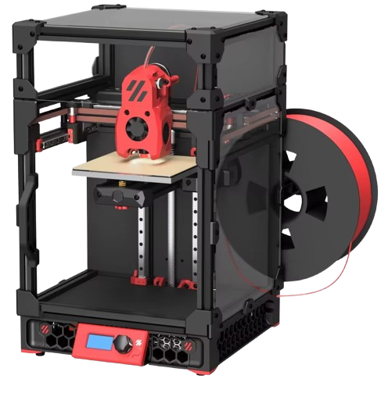

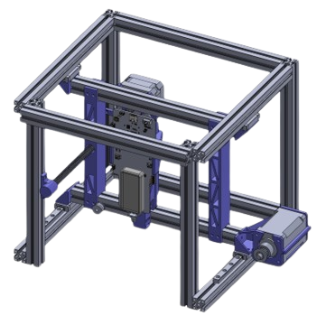

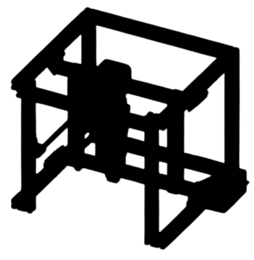

Notes:
The 3D positioner needs to be designed with a few key features in mind. First of all, it must be low-cost: the goal is to make it accessible to anyone, even with limited resources, so that the experiment can be replicated or improved by others. Secondly, it should be hackable, meaning it must be easy to modify and customize. Users should be able to tweak the design, firmware, or software to suit their specific needs or to enhance its functionality. Finally, it’s essential that the positioner is open-source and open-hardware. This ensures collaboration and accessibility. All design files, code, and documentation should be freely available so that the community can contribute, fix bugs, and suggest new features.

Slide 13
Design guidelines
Our main goal was to use the printer’s construction as a basis on which to build upon to fit our use case, taking advantage only of the pieces that had been provided to us and several 3d printed parts to mount them together.
Notes:
4 minutes
Using only the printers parts
Finding the right frame extrusions
Lining up holes and using the right screw
Brainstorming the new layout
Designing the adapter pieces
Hardships during cad
Design characteristics

Slide 14
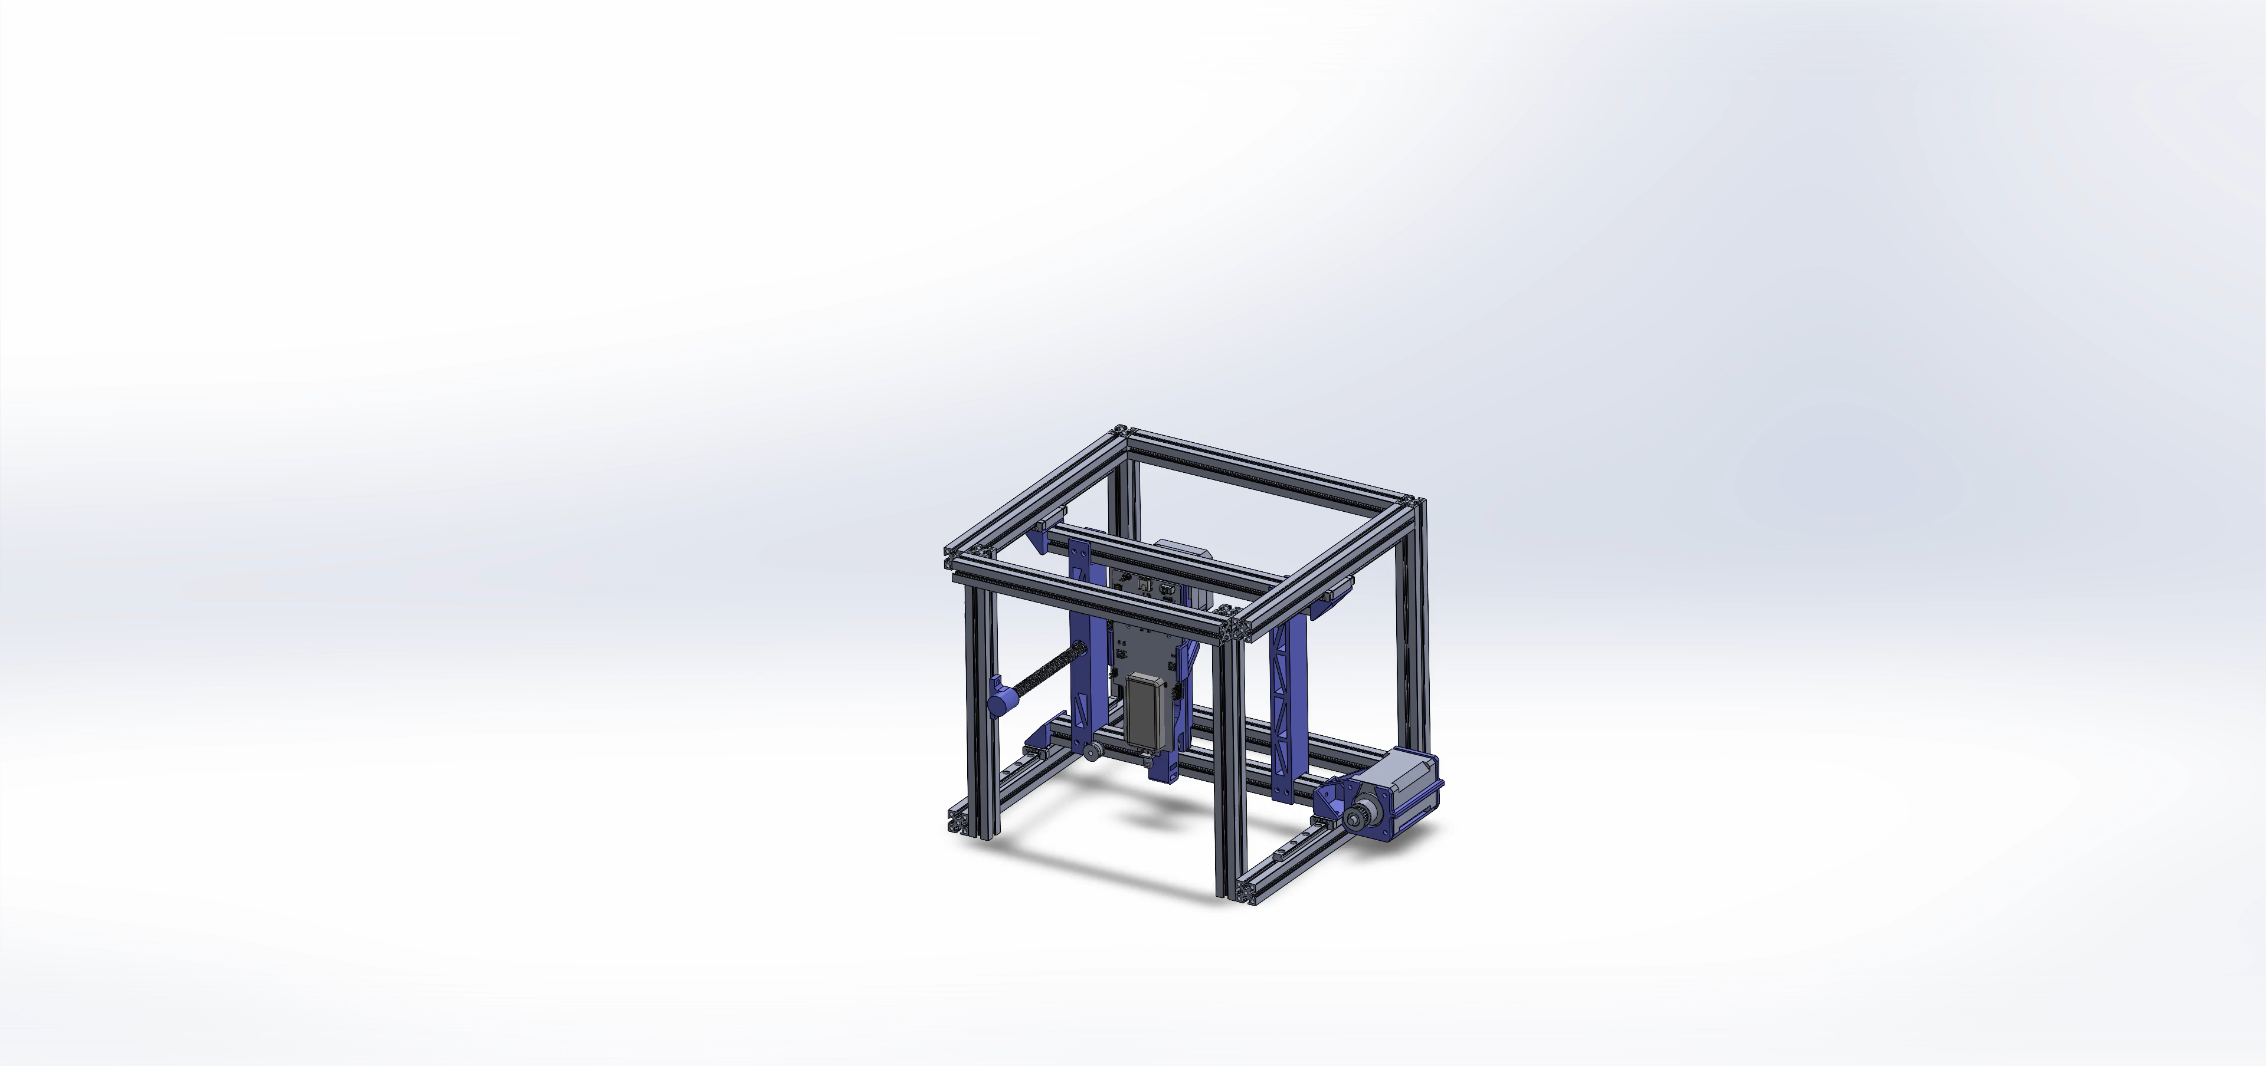

Slide 15
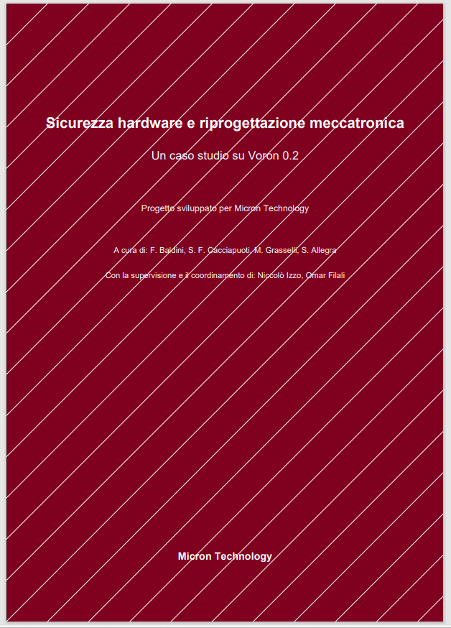
Requirements / Documentation
A strategic effort throughout the entire project: defining clear goals, constraints, and requirements guided every decision, ensuring efficient use of time and materials, and keeping the development aligned with the final objective.
Notes:
4 minutes

Slide 16
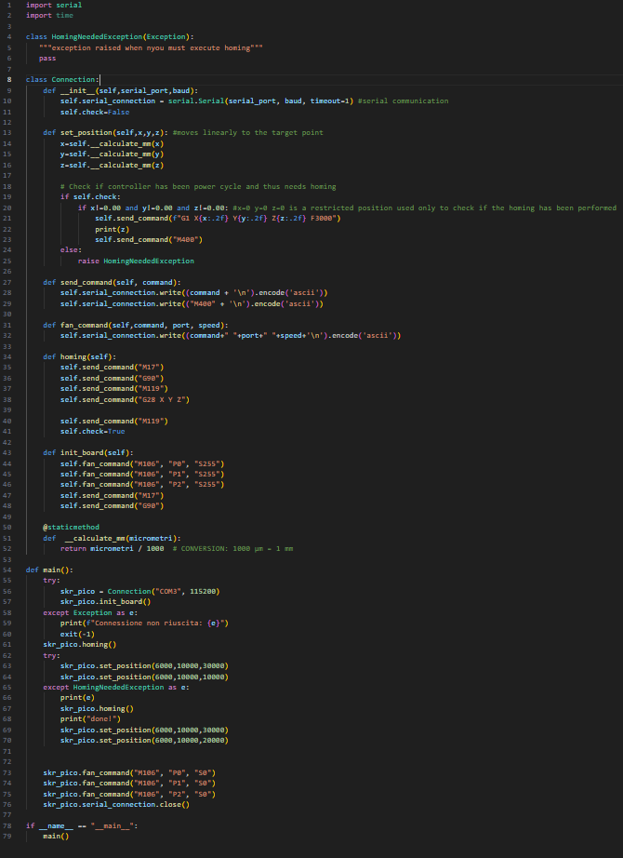
Software
Using Python, we developed a library to hack the 3D printer. Starting from three coordinates (X,Y,Z) we handled the transmission of G-CODE commands to the printer to move the extrusor on a certain position that reflects the coordinates indicated.
Notes:
5 minutes

Slide 17
THANK YOU FOR THE ATTENTION!

